Slide 1
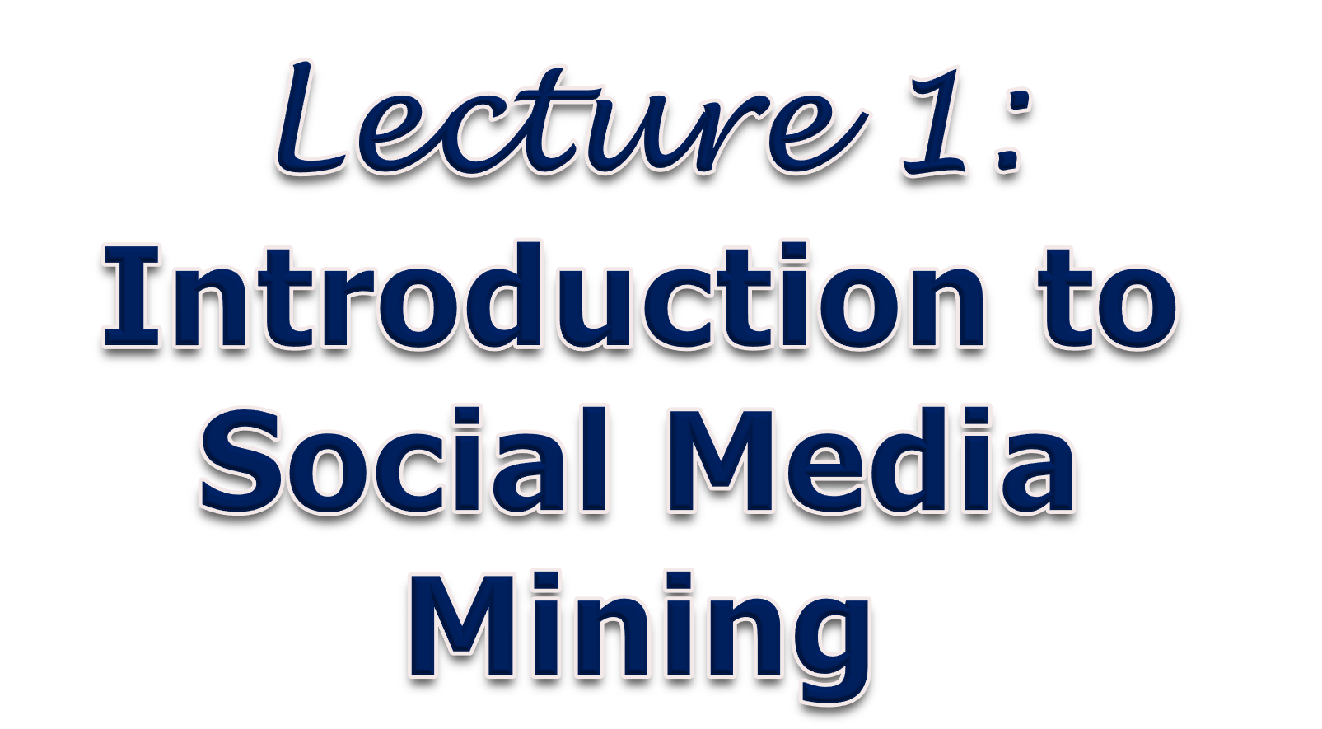
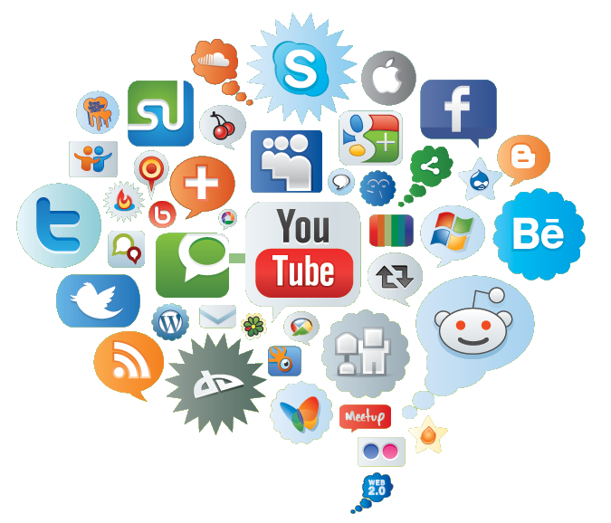
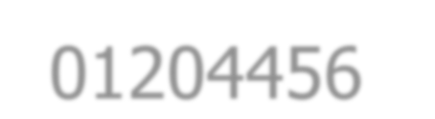







01204456 Social Networks Data Mining
Department of Computer Engineering Faculty of Engineering, Kasetsart University Bangkok, Thailand.

Slide 2

Networks & Complex Systems
Complex systems are around us:
Society is a collection of seven billion individuals
Communication systems link electronic devices
Information and knowledge is organized and linked
Interactions between thousands of genes regulate life
Our thoughts are hidden in the connections between billions of neurons in or brain
What do these systems have in common?

Slide 3

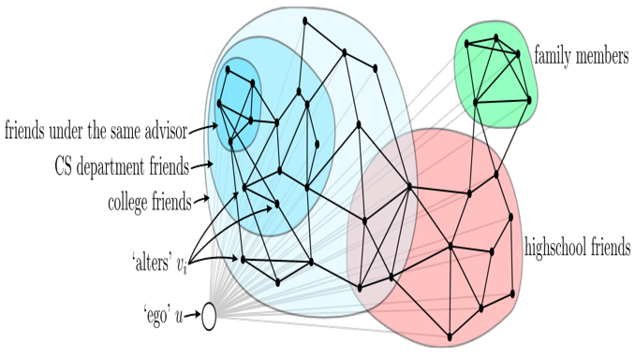
Ego Networks
McAuley and Leskovec, 2012

Slide 4


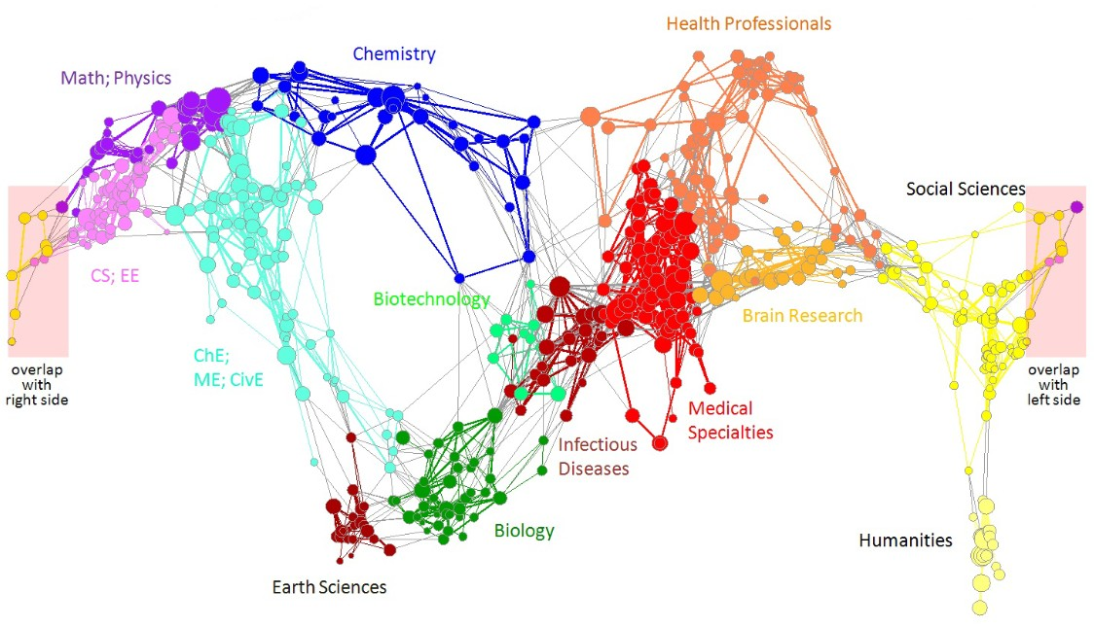
Information Networks
Citation networks and Maps of science
Börner et al., 2012

Slide 5


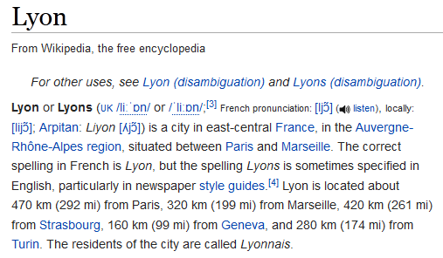
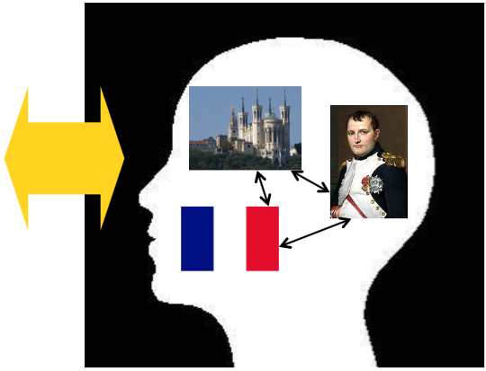


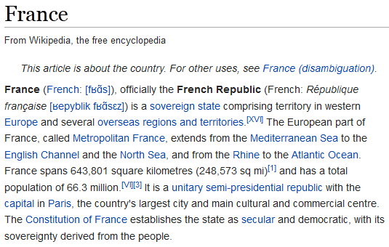
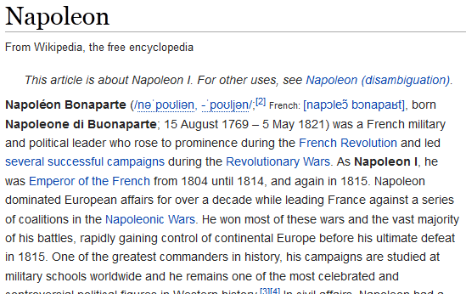
Knowledge Networks
Understand how humans navigate Wikipedia
Get an idea of how people connect concepts
West and Leskovec, 2012

Slide 6


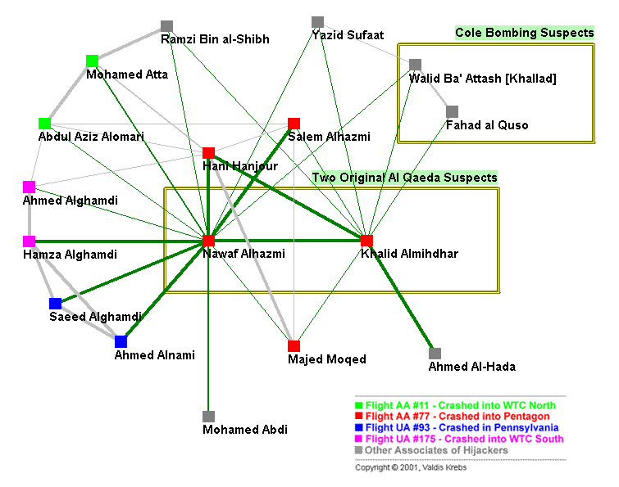
Organization Networks
Terrorist Network
Krebs, 2002

Slide 7



Brain Networks
Human brain has between 10-100 billion neurons
Sporns, 2011

Slide 8


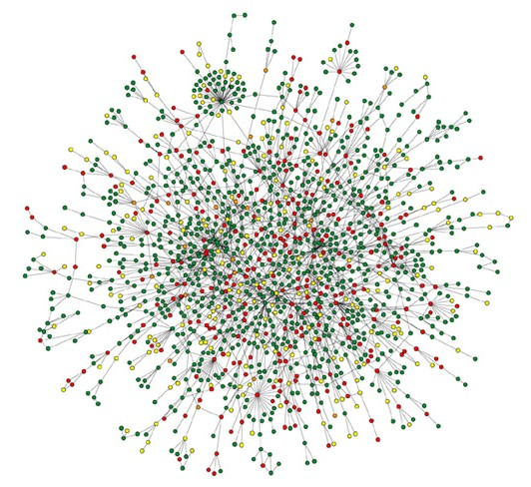
Biology Networks
Protein-Protein Interaction Networks
Nodes: Proteins
Edges: Physical interactions
Barabási and Oltvai, 2011

Slide 9

Online Networks
Communication networks
Social networks
Information networks
– Navigational aids

Slide 10

Networks !!
Behind many systems there is an intricate wiring diagram, a network, that defines the interactions between the components
We will never understand these systems unless we understand the networks behind them!
10

Slide 11


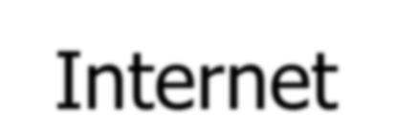




The Internet & Social Media
Internet has changed the way of our everyday life
Buy music, see movie, organize vacations, etc.
Effect how people interact socially.
Though the use of social media, people can:
Exchange photo and video
Share new stories
Post their thoughts on blogs
Participate in online discussion
– …
Social media also allow individuals, companies, organizations, to interact with large number of people.
Privacy concern: the ways in which personal information that is shared by social media users may be collected and analyzed.

Slide 12


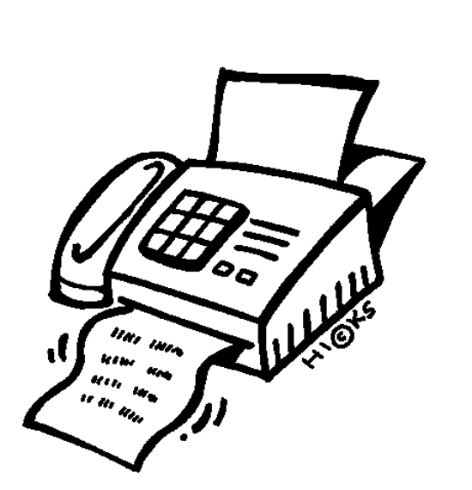
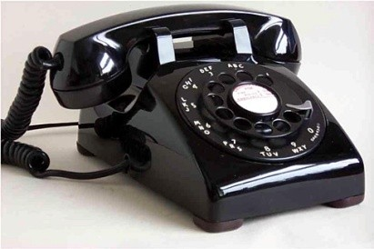
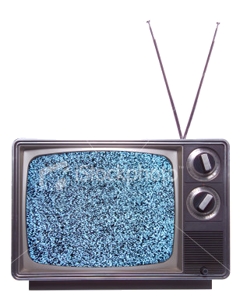
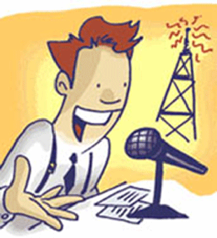

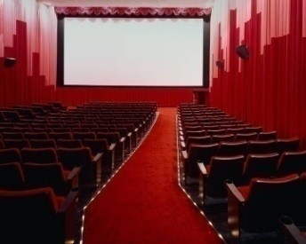
Traditional Media
Communication Media: One-to-One
Broadcast Media: One-to-Many

Slide 13
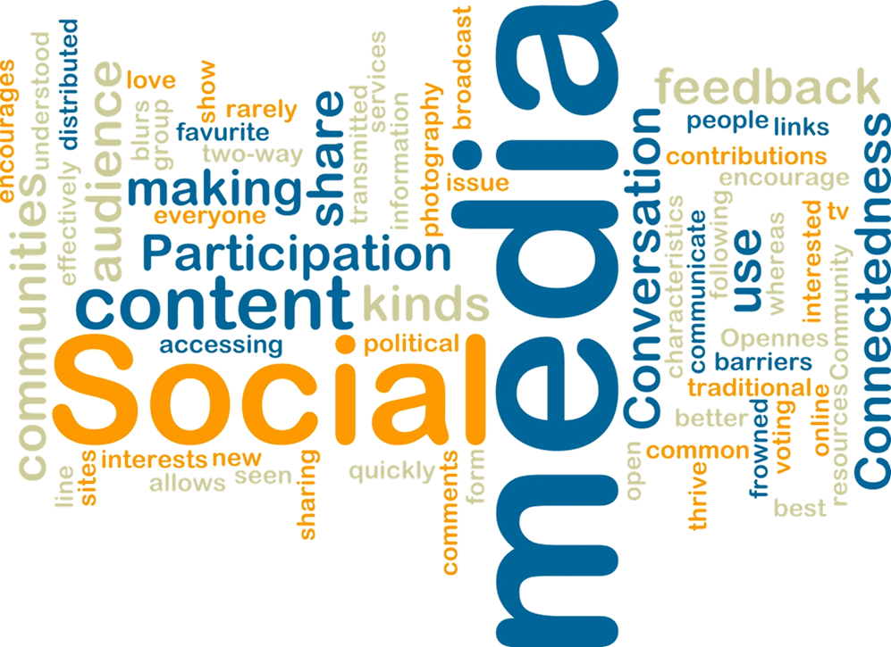



Slide 14

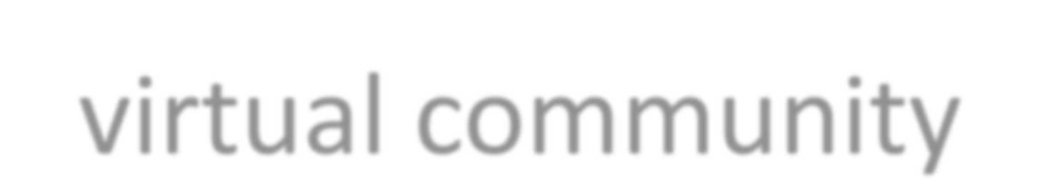
Social Media
“A virtual community where people with common interests can gather and connect, to share stories, ideas, thoughts, and opinions”

Slide 15




































Social Media: Many-to-Many
Social Networking
Content Sharing
Social Media
Blogs Microblogging
Wiki Forum

Slide 16

Various forms of Social Media
Blog: An online journal in which pages are usually displayed in reverse chronological order.
Wordpress, blogspot, LiveJournal
Forum: Share knowledge, suggest, post opinion
Yahoo! Answers, Epinions
Media Sharing: Allow users to post photos, videos
Flickr, YouTube, Scribd
Microblogging: Allow people to share short updates about people or events and to see updates created by others.
Twitter, FourSquare, Instagram

Slide 17


Various forms of Social Media (2)
Social Networking: Web-based services that allow individual to
construct a public or semi-public profile within a bounded system,
articulate a list of other users with whom they share a connection, and
view and traverse their list of connections and those made by others within the system.
Facebook, LinkedIn, Orkut
Social Bookmarking: Allow users to organize and share links to websites.
Del.icio.us, Diigo
Wikis: A collective website where any participant is allowed to modified or create a page via her web browser.
Wikipedia, Scholarpedia, AskDrWiki

Slide 18
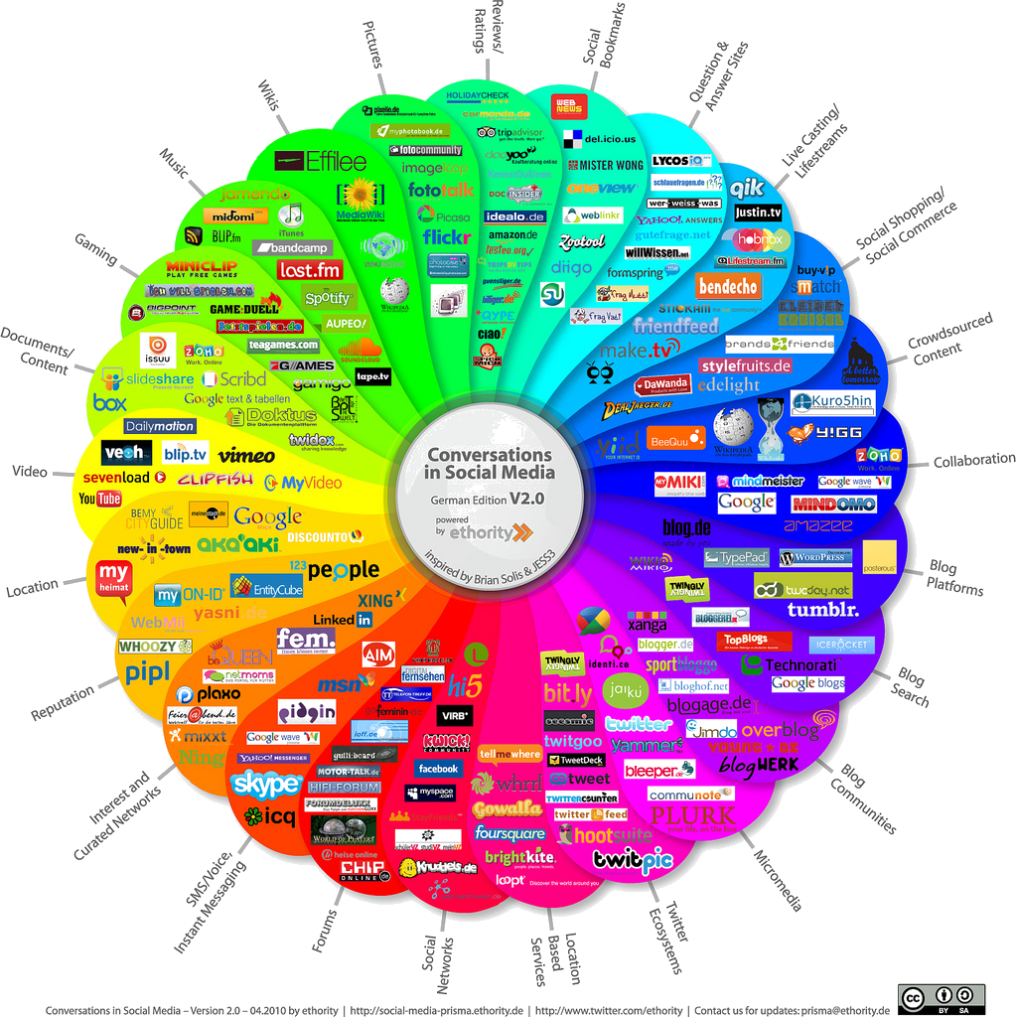

Slide 19

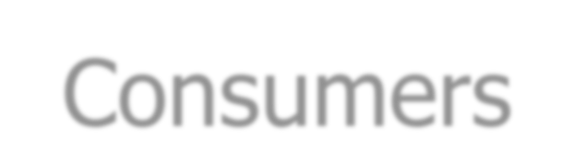
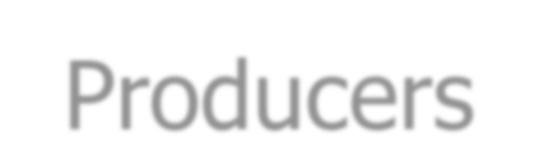
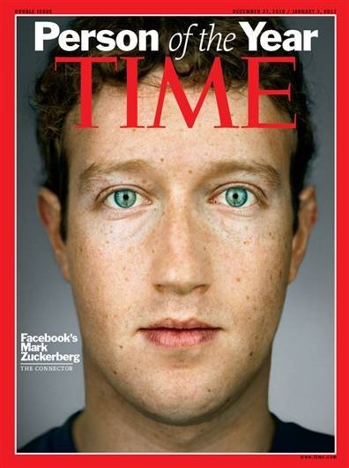
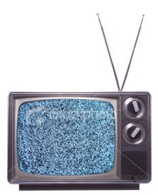




Characteristics of Social Media
Consumers become Producers
Rich User Interaction
User-Generated Contents
Collaborative Environment
Collective Wisdom
Long Tail
• …
Broadcast Media
Filter, then Publish
Social Media
Publish, then Filter

Slide 20




Top-20 Traffic Websites in Global
1 | Google.com | 11 | Google.co.in
2 | Facebook.com | 12 | Live.com
3 | YouTube.com | 13 | Sina.com.cn
4 | Yahoo.com | 14 | Weibo.com
5 | Baidu.com | 15 | LinkedIn.com
6 | Amazon.com | 16 | Tmall.com
7 | Wikipedia.org | 17 | Yahoo.co.jp
8 | Twitter.com | 18 | Blogspot.com
9 | Taobao.com | 19 | Ebay.com
10 | Qq.com | 20 | Hao123.com
Most of websites are social media sites.
From Alexa, January 2015
20

Slide 21








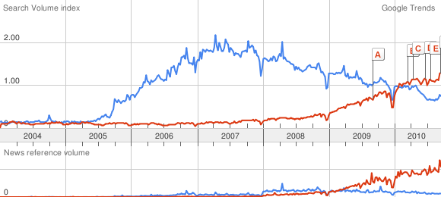
Search the phrases Web 2.0 vs. Social Media
From kang74.wordpress.com
The above graph which clearly shows that “in 2009, Social media (red) is starting to overtake Web 2.0 (blue) worldwide”.

Slide 22


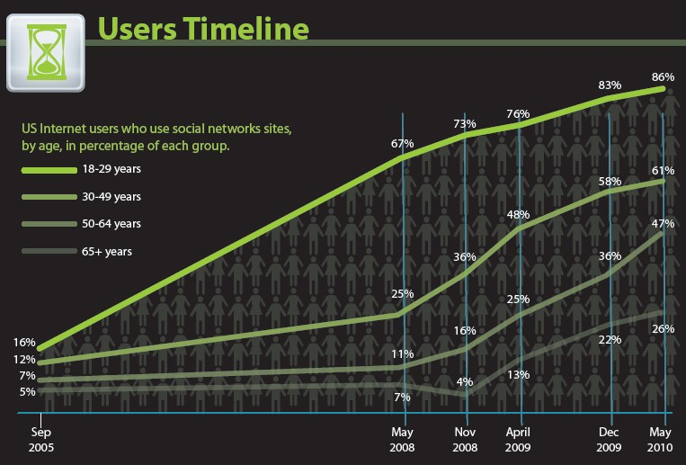
Users Timeline
Source: http://www.searchenginejournal.com

Slide 23


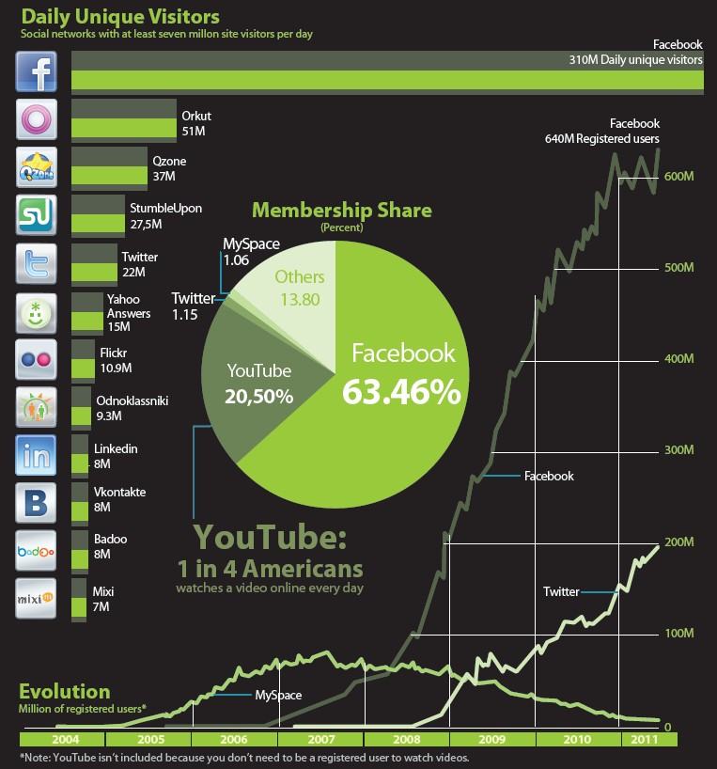
Social Media Visitor Growth
Source: http://www.searchenginejournal.com

Slide 24



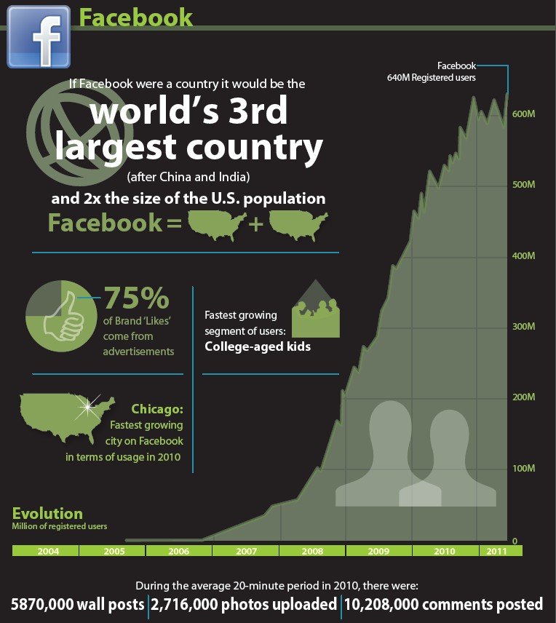
Facebook’s Population
Source: http://www.searchenginejournal.com

Slide 25


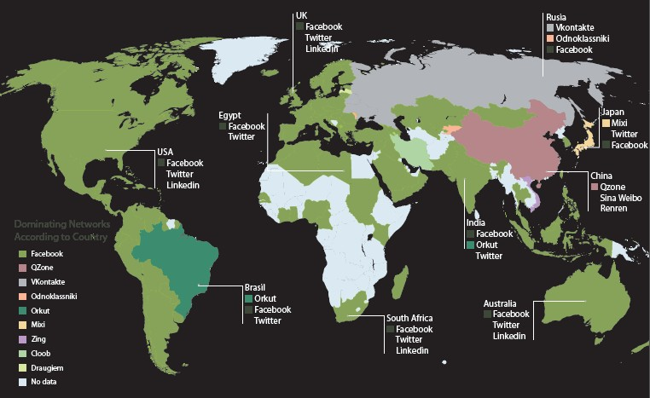
World of Social Media
Source: http://www.searchenginejournal.com

Slide 26



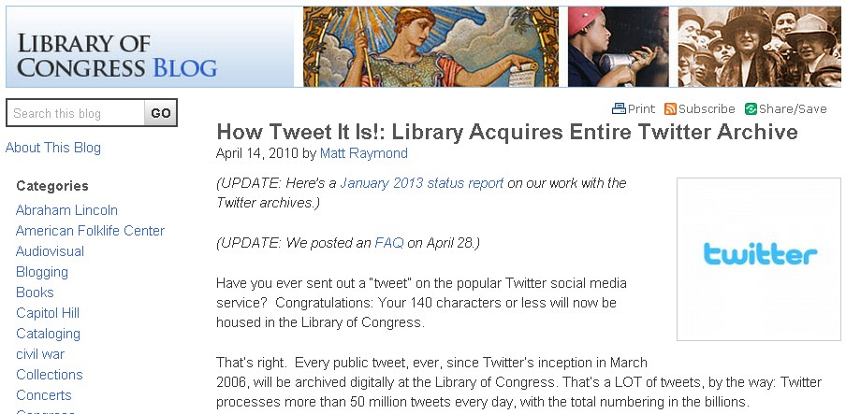
Social Media Mining

Slide 27



Social Media Mining (SMM)
“The process of representing, analyzing, and extracting meaningful patterns from social media data”

Slide 28

SMM Components
Social media
Content and link data
Observational data
Social networks
Models: Interactions
Mining
Techniques: description or prediction

Slide 29




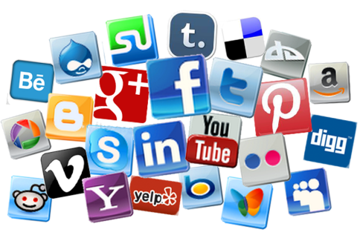











SMM Framework
Social Media Data
Representation
SMM Tasks
Community detection
Influence modeling
Recommendation
• …
Mathematics
Statistics and Probability
Graph Theory
Mining Techniques
Large-Scale Computing
• …

Slide 30


Network and Representations
Social network – a social structure made of
nodes: edges:
individuals
social relationship (kinship, friendship, interactions, etc.)
Graph representation • Matrix representation
 | 0 | 1 | 1 | 1 | 0 | 0 | 0 | 0 | 0
 | 1 | 0 | 1 | 0 | 0 | 0 | 0 | 0 | 0
 | 1 | 1 | 0 | 1 | 0 | 0 | 0 | 0 | 0
 | 1 | 0 | 1 | 0 | 1 | 1 | 0 | 0 | 0
 | 0 | 0 | 0 | 1 | 0 | 1 | 1 | 1 | 0
 | 0 | 0 | 0 | 1 | 1 | 0 | 1 | 1 | 0
 | 0 | 0 | 0 | 0 | 1 | 1 | 0 | 1 | 1
 | 0 | 0 | 0 | 0 | 1 | 1 | 1 | 0 | 0
 | 0 | 0 | 0 | 0 | 0 | 0 | 1 | 0 | 0
7
5
3
9
1
4
8
6
2
30

Slide 31

Basic Concept
A: the adjacency matrix
V: the set of nodes
E: the set of edges
v_{i}: a node v_{i}
•
•
•
•
 | 0 | 1 | 1 | 1 | 0 | 0 | 0 | 0 | 0
 | 1 | 0 | 1 | 0 | 0 | 0 | 0 | 0 | 0
 | 1 | 1 | 0 | 1 | 0 | 0 | 0 | 0 | 0
 | 1 | 0 | 1 | 0 | 1 | 1 | 0 | 0 | 0
 | 0 | 0 | 0 | 1 | 0 | 1 | 1 | 1 | 0
 | 0 | 0 | 0 | 1 | 1 | 0 | 1 | 1 | 0
 | 0 | 0 | 0 | 0 | 1 | 1 | 0 | 1 | 1
 | 0 | 0 | 0 | 0 | 1 | 1 | 1 | 0 | 0
 | 0 | 0 | 0 | 0 | 0 | 0 | 1 | 0 | 0
7
5
3
9
4
1
8
6
2
e(v_{i},v_{j}): an edge between node v_{i} and v_{j} N_{i}: the set of neighbors of node v_{i}
d_{i}: the degree of node v_{i}
geodesic: a shortest path between two nodes
– g(v_{i},v_{j}): geodesic distance between node v_{i} and v_{j}
d₁ = ?
d₄ = ?
g(2,8) = ?

Slide 32

Some Interesting Quantities
Connected components:
How many?
 Few connected components (often only 1, or a small number)
Network diameter:
How long (average)?
 Small diameter (often constance, like 6, or logarithmical growth)
Clustering coefficient:
How characteristics?
 High in average (much greater than for a random network)
Degree distribution:
What distribution?
 Long tail degree distribution (i.e., power law)

Slide 33



Properties of Large-Scale Networks
Networks in social media are typically huge, involving millions of nodes and connections.
Large-scale networks in real world demonstrate similar patterns.
Scale-free distributions
Small-world effect
Strong Community Structure

Slide 34

Challenges
Scalability
Social networks are often in a scale of millions of nodes and connections.
Traditional Network Analysis often deals with at most hundreds of subjects.
Heterogeneity
Various types of entities and interactions are involved.
Evolution
Timeliness is emphasized in social media.
Collective Intelligence
How to utilize wisdom of crowds in forms of tags, wikis, reviews?
Evaluation
Lack of ground truth, and complete information due to privacy.

Slide 35

SMM Tasks
Network modeling
Community detection
Centrality analysis
Influence modeling
Classification and recommendation
User behavior characterization
Sentiment analysis and opinion mining
Privacy, spam, and security
• …

Slide 36

Network Modeling
Large networks demonstrate statistical patterns:
Power-law distribution (a.k.a. scale-free distribution)
Small-world effect (e.g., 6 degrees of separation)
Community structure (e.g., high clustering coefficient)
Model the dynamic network
Use simulation to understand other network properties
Use sampling technique to provide a small portion of network

Slide 37

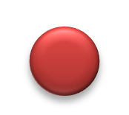
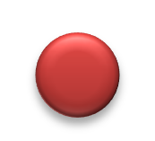


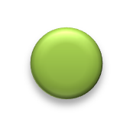






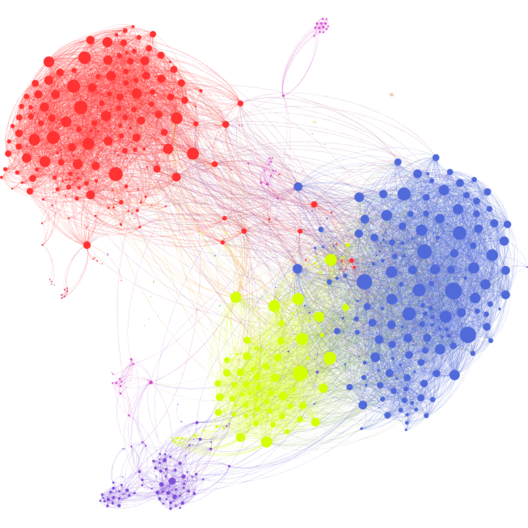
Community Detection
Community – a set of nodes between which the interactions are (relatively) frequent
7 3
7
3
5 5
9
1 9
1
4
4
8 6
2
8
6
2
Applications:
Recommendation based communities
Network compression
Visualization
– …
Source: https://griffsgraphs.wordpress.com/2012/07/02/a-facebook-network/

Slide 38

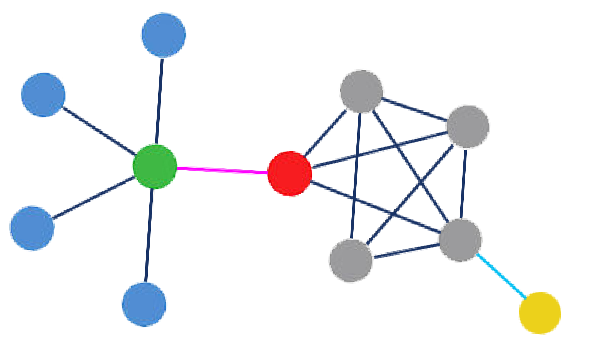
Centrality analysis
Centrality – the most important nodes or edges
Various criteria:
Traditional: degree centrality, betweenness centrality, closeness centrality, and eigenvector centrality
Social media: comments and tags

Slide 39



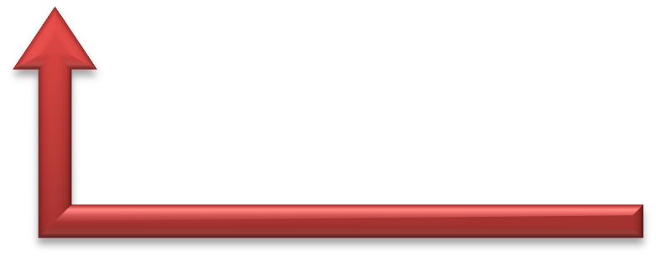


Social Influence
Influence – actions of earlier persons affect that of later persons
Backward network engineering
Forward network engineering
Backward predictions
Forward predictions
Learn from observed data
Forward Predictions:
viral marketing, influence maximization
Backward Predictions:
effector/initiator finding, cascade detection, sensor placement

Slide 40

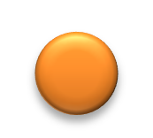
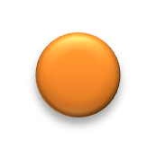



















Classification and Recommendation
Network-based classification
+
₅ ?
?
+
₅ +
–
7
3
7
3
?
–
+
–
9
?
4
1
9
+
4
1
? 8 6 +
Link prediction
2
–
+ 8
6 +
2
–
7
5
3
7
5
3
9
1
9
1
4
4
8 6
2
8 6
2
Applications:
– Tag suggestion, friend(s) recommendation, …
40

Slide 41











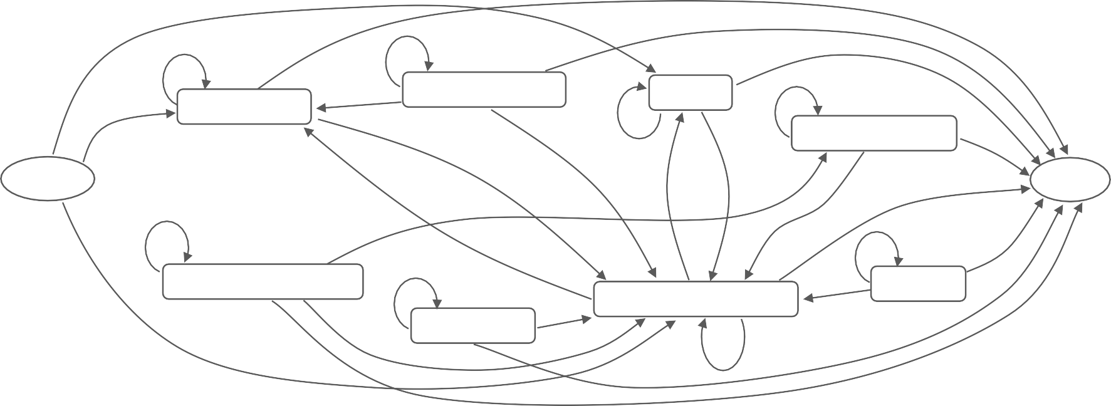
User Behavior Characterization
traffic logs
mining
frequent
patterns
0.08
0.68
0.02
0.67
0.03
0.82
Communities
0.09
Scrapbook
0.04
Testimonials
Photo
0.86
0.23
0.11
0.09
Initial
0.20
0.04
Final
0.71
0.10
0.05
0.68
Videos
0.09
0.64
0.71
0.22
0.07
0.10
Universal Search
0.16
0.04
Profile & Friends
0.16
0.17
Messages
0.69
0.07
Applications:
– UI improvement, advertisement, …

Slide 42





























Sentiment Analysis and Opinion Mining
“Computational study of opinions, sentiments, and emotions expressed in text”
each sentence of a review
Subjectivity Classification
Sentiment Classification
positive negative neutral
Ex. I bought an iPhone two days ago. ✗  It is such a nice phone.✓
Application: Decision support system
Comparison of reviews
Cell Phone 1
Cell Phone 2
+
–
voice screen battery size weight

Slide 43



Privacy, Spam and Security
Privacy is a big concern in social media.
Facebook, Google buzz often appear in debates about privacy.
Simple anonymization does not necessarily protect privacy.
Spam blog (splog), spam comments, Fake identity, etc., all requires new techniques.
As private information is involved, a secure and trustable system is critical.
Need to achieve a balance between sharing and privacy.

Slide 44

Acknowledgement
Many slides are adapted and come from:
Chapter 1, Community Detection and Mining in Social Media, L. Tang & H. Lui, Morgan & Claypool Publisher, 2012.
CS249B Science of Networks, CS@Wellesley College, 2008.

Slide 45


